Slide 1
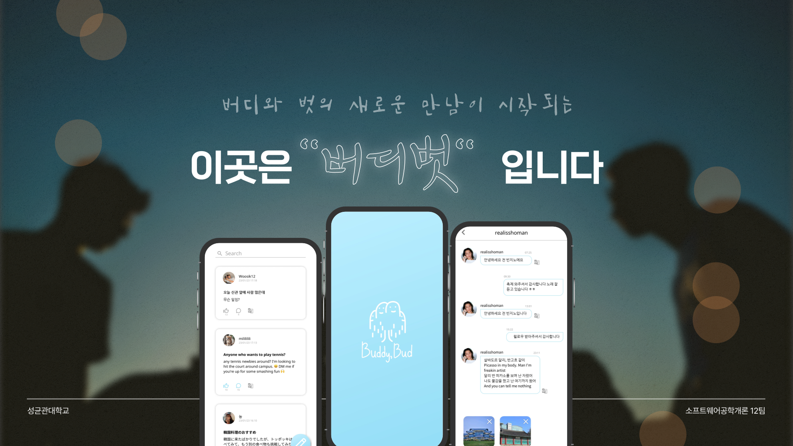

Slide 2


Software Engineering Team 12
Contents
1. Motivation for the Project
- Demographic overview
- Drawbacks of Everytime
2. Project Goal
- Benchmarking models
- Service Goal
3. Testing
- GreyBox Testing
- Result
4.Demo video
-Video
2
Team 12

Slide 3
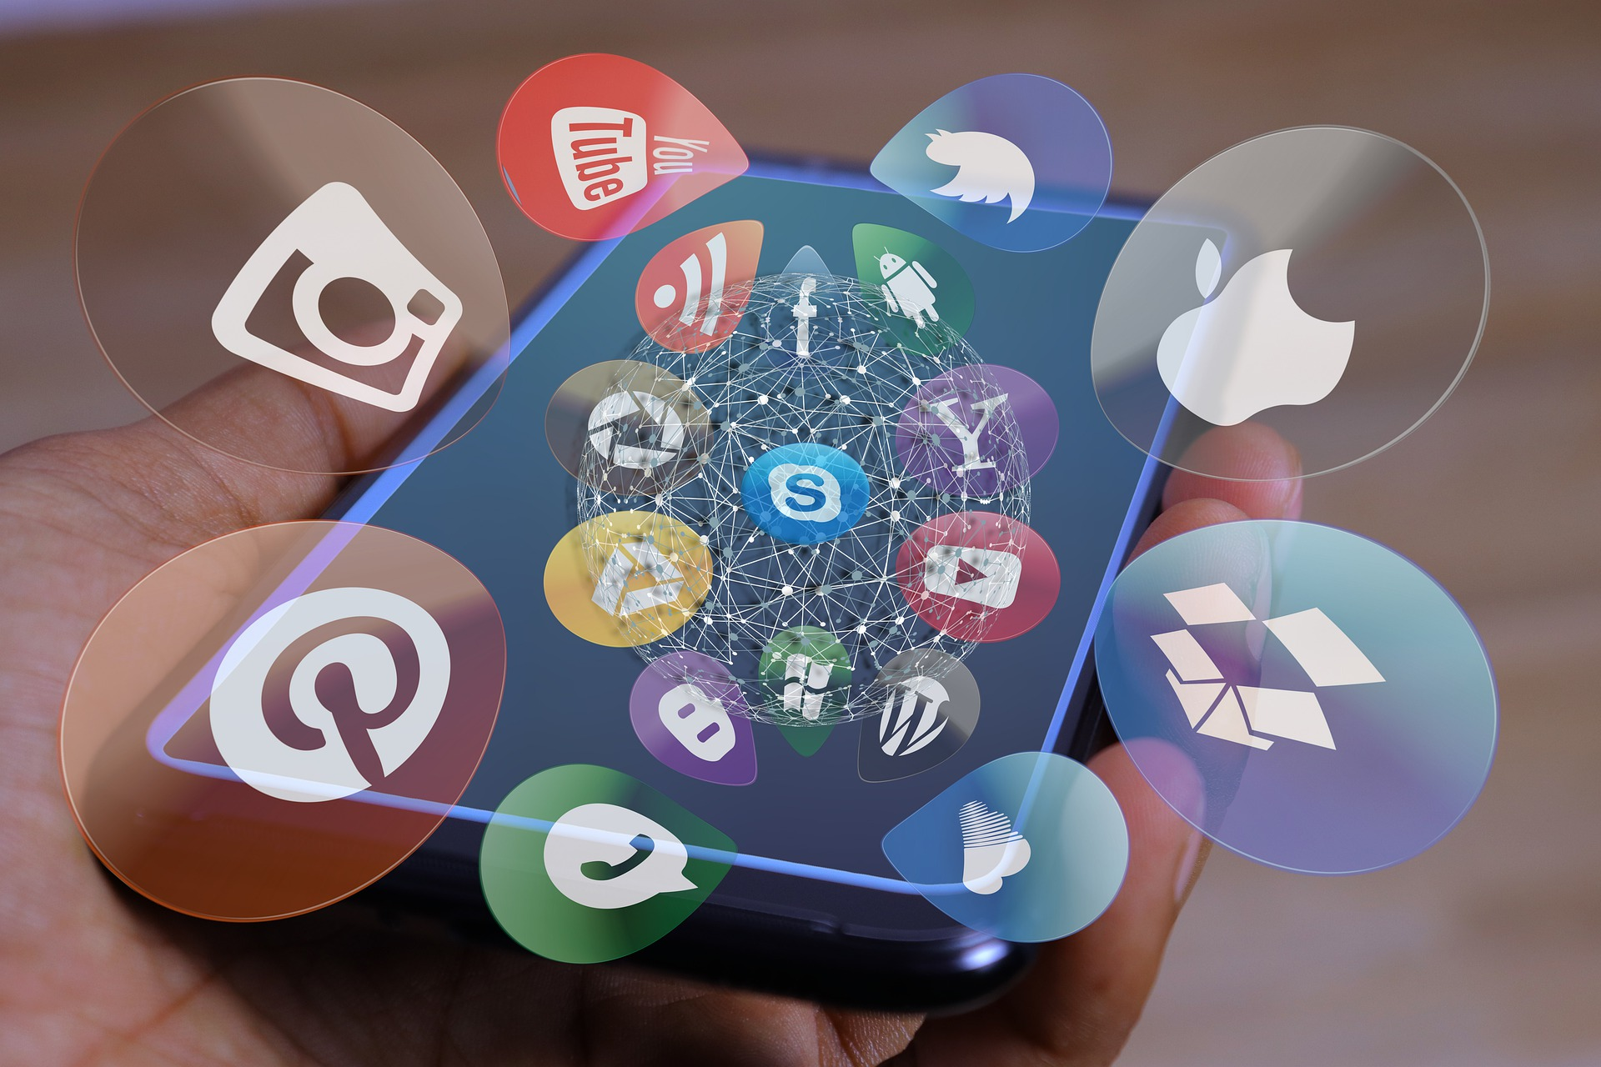
Software Engineering Team 12
BuddyBud
01 Motivation for the Project

Slide 4
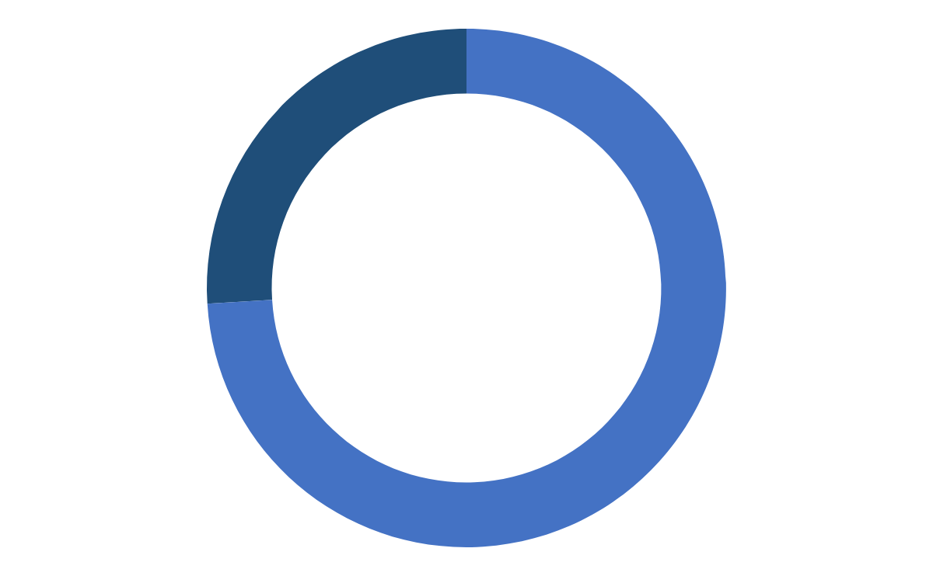
Software Engineering Team 12
Demographic Overview
Ratio of International Students in SKKU
International Students - 4,751
26.0%
# of all stdnt
18,298
Korean Students - 13,547
74.0%
4
Team 12

Slide 5

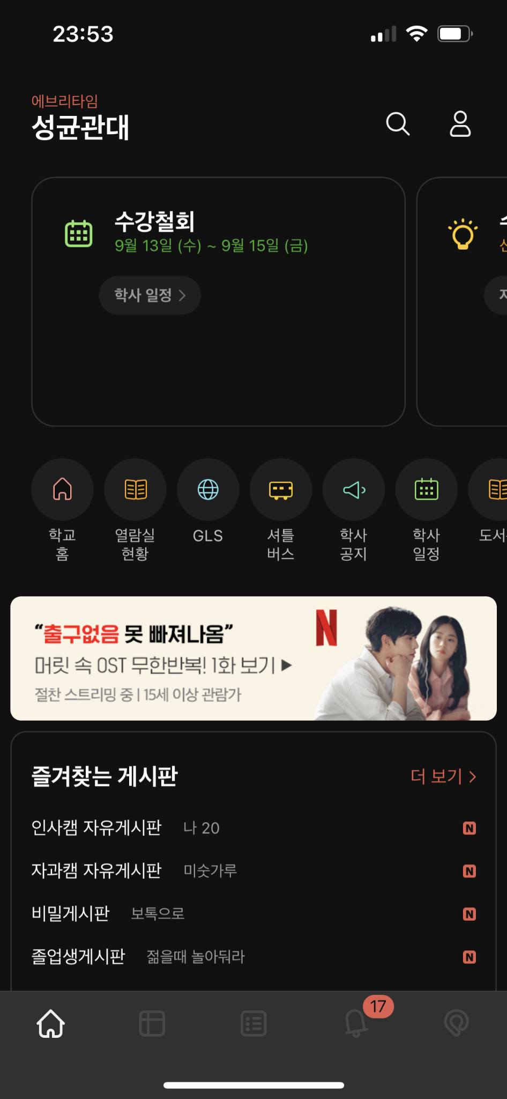




Software Engineering Team 12
Drawbacks of Everytime
01
The closedness of the international student community
- It’s hard to get information about the school.
ex) School life tips, restaurants near the school, club recruitment, etc.
- There’s no bulletin board for international students.
5
Team 12

Slide 6

Software Engineering Team 12
Drawbacks of Everytime (cont’d)
?
02
Absence of Translation Feature
- There’s no function to instantly translate posts and comments.
- International students who are not familiar with Korean inevitably face many inconveniences when using the community app.
6
Team 12

Slide 7



Software Engineering Team 12
Drawbacks of Everytime (cont’d)
03
Issues with Interaction between International and Korean Students
- Apart from events like the "Hi-Club" and international exchange gatherings, there are few easy ways for Korean students and international students to interact.
7
Team 12

Slide 8

Software Engineering Team 12
BuddyBud
02 Project Goal

Slide 9
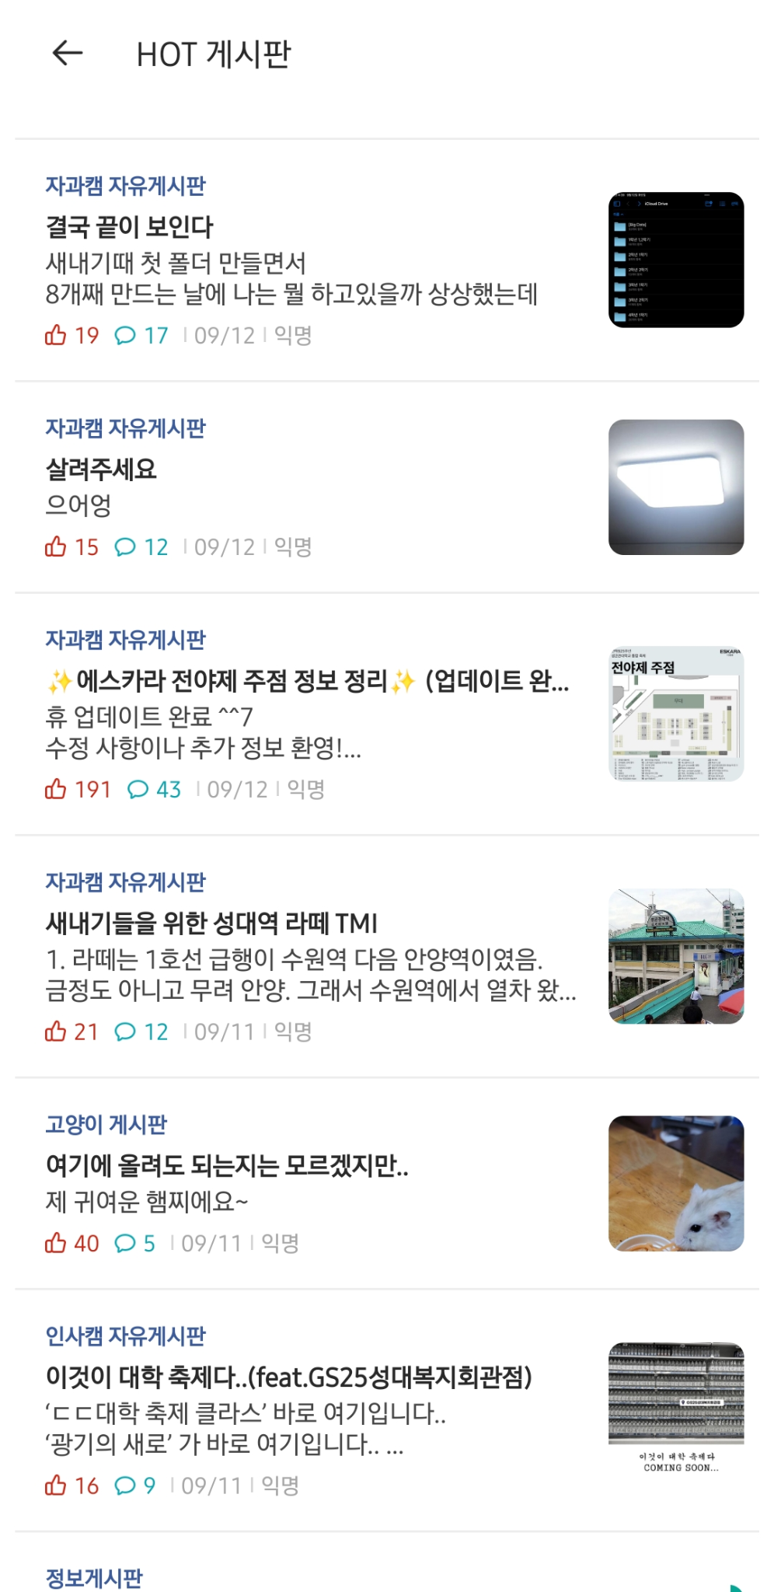
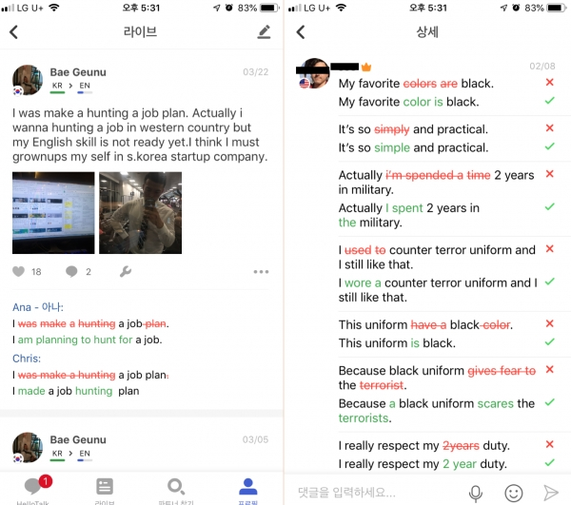
Software Engineering Team 12
Benchmarking Model
Everytime
HelloTalk
- the largest univ. stdnt community
- Ensured anonymity, communities by school
- Time table sharing, various promotional activities, etc.
- Language exchange app
- auto translation
- 1:1 Chat and Daily Communities
- Language calibration, suggestion function
9
Team 12

Slide 10

Software Engineering Team 12
Features in Detail
Free & Lively Community
Auto Translation
A space where students can freely share opinions and make friends
Overcoming language barriers by automatically translating text/comments/chat to suit your language
semi- anonymity
We do digital Things!
1:1 Chat
ID+profile photos are mandatory to prevent people from speaking or behaving in violent or rude manner
Encourage private communication by allowing users to freely chat with each other
School life tips, Q&A
Various club/meetup
Promotion
A place of communication where students can solve problems faced by foreign students and share various tips
When you need a meal friend, a drinking friend, or a study mate, an active club
10
Team 12

Slide 11
Software Engineering Team 12
Service Goal
Based on the aforementioned features, ultimately facilitate the interaction between foreign and Korean students, and provide information sharing and a community
11
Team 12

Slide 12
Software Engineering Team 12
BuddyBud
03 Testing

Slide 13

Software Engineering Team 12
GreyBox Testing
Grey-Box Testing
Obtaining only partial information from each program execution
Relatively cheap and Systematic
Mutation-Based Fuzzing
Chose the method to test the “Sing Up” function
13
Team 12

Slide 14
Software Engineering Team 12
GreyBox Testing - Strategy
Seed Selection
Seed Mutation
Deterministic
Checker
14
Team 12

Slide 15
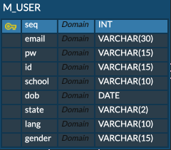
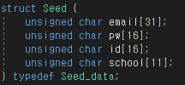
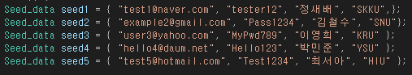
Software Engineering Team 12
GreyBox Testing - Seed Selection
Seed Selection
Seed Mutation
Deterministic
Checker
Create 5 valid seed inputs
Each seed contains “email”,”PW”,”ID”,”School”,”
15
Team 12

Slide 16
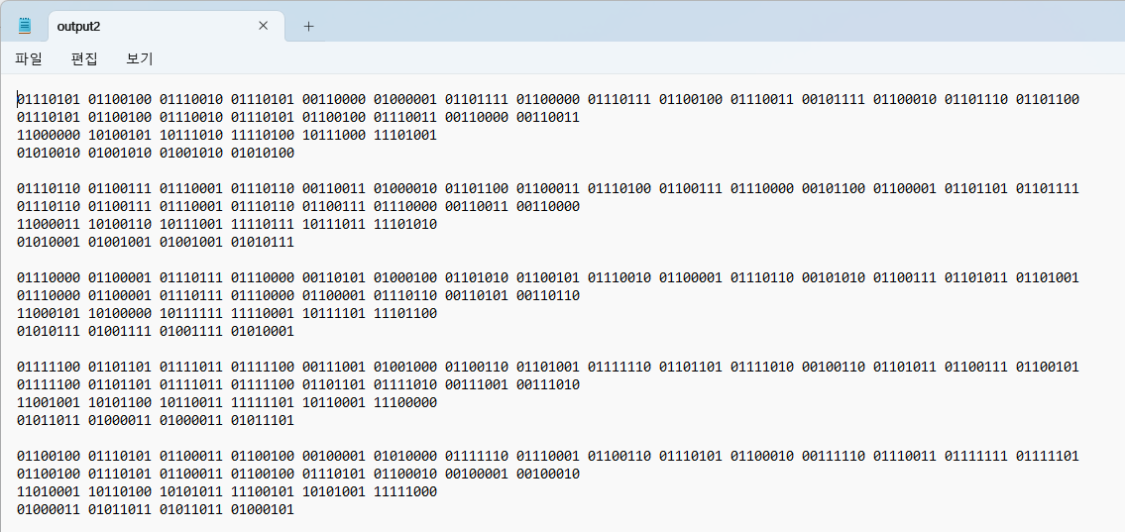
Software Engineering Team 12
GreyBox Testing - Seed Mutation
Seed Selection
Seed Mutation
Deterministic
Checker
Deterministic stage only
1 Bit flip operator flips the nth bit of nth mutation of each seed input, n = 10
16
Team 12

Slide 17
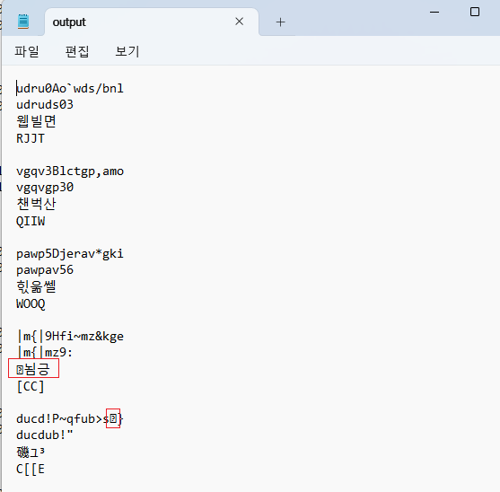
Software Engineering Team 12
GreyBox Testing - Checker
Seed Selection
Seed Mutation
Deterministic
Checker
Checker checks if there is non-printable character in the mutants
Only mutants without non-printable character is executed
17
Team 12

Slide 18
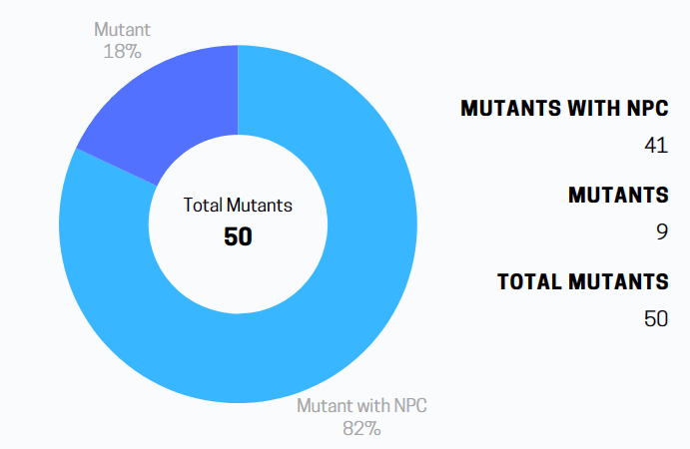
Software Engineering Team 12
GreyBox Testing - Result
Meaningless Test Cases were generated
18
Team 12

Slide 19
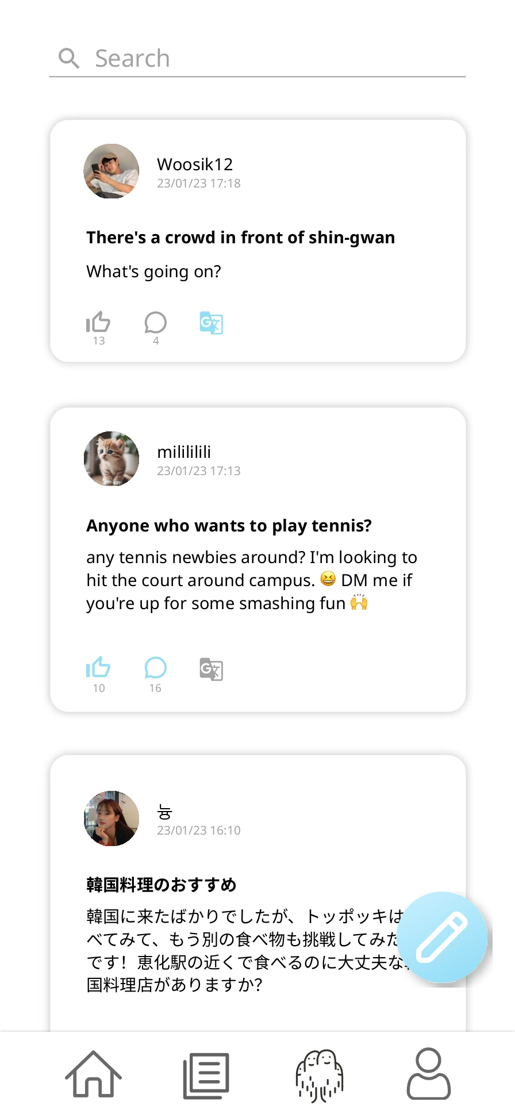
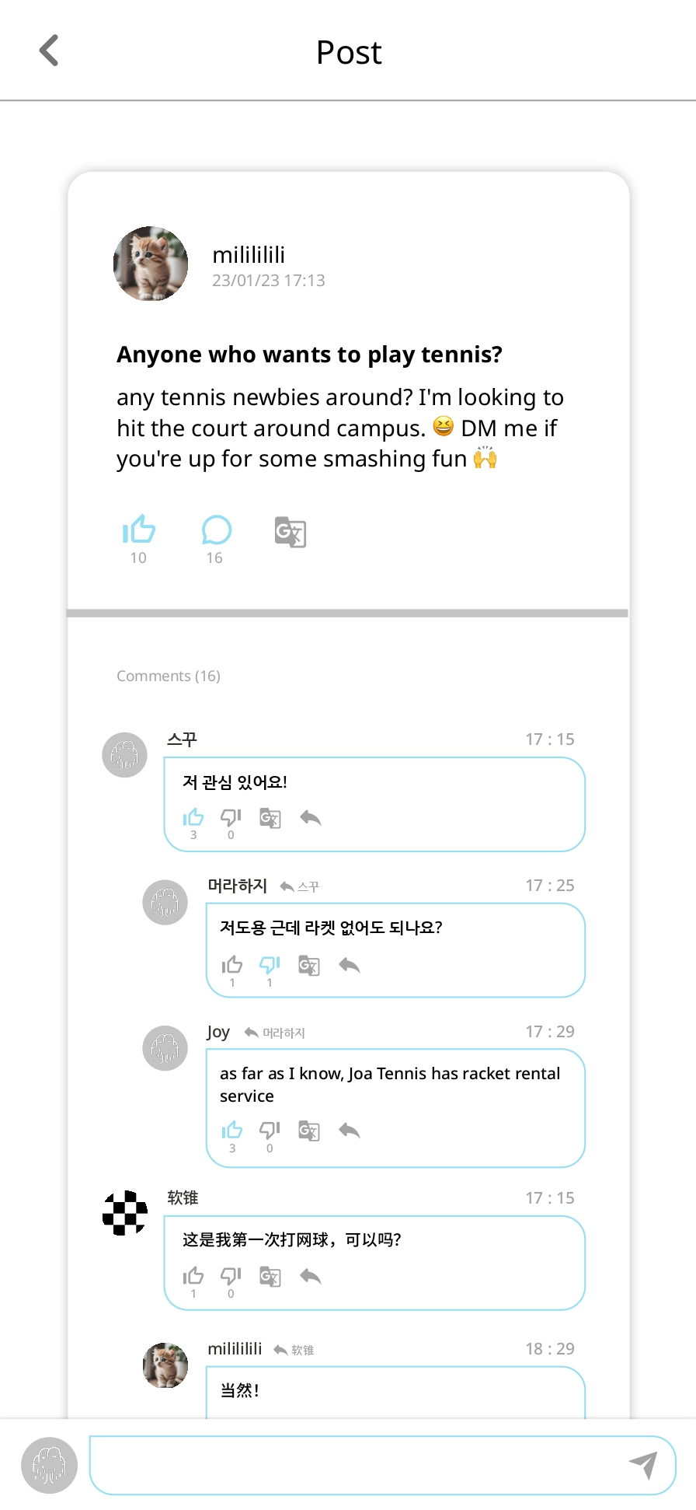
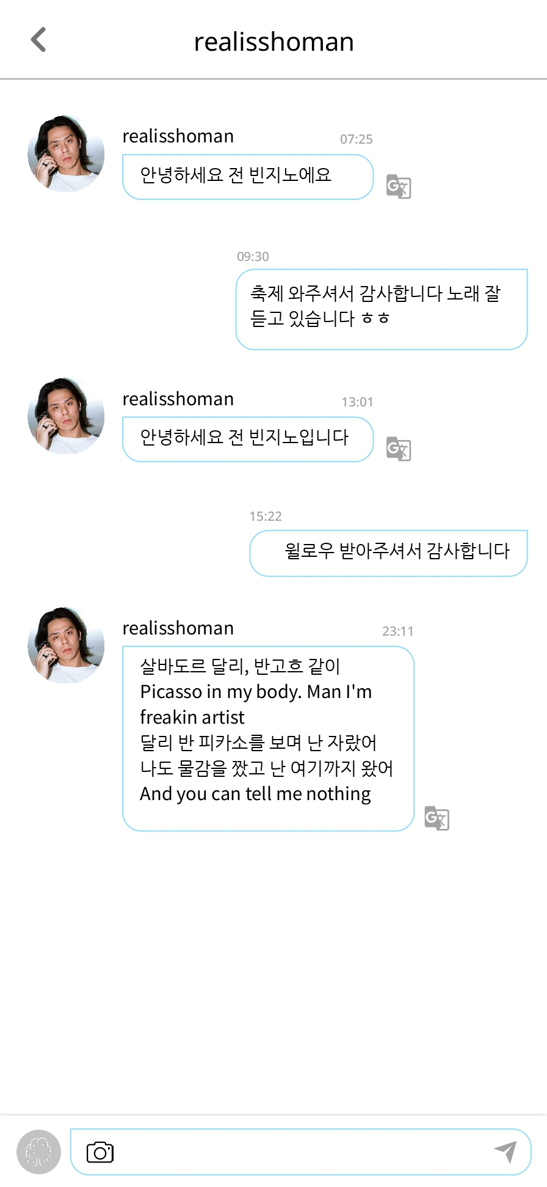
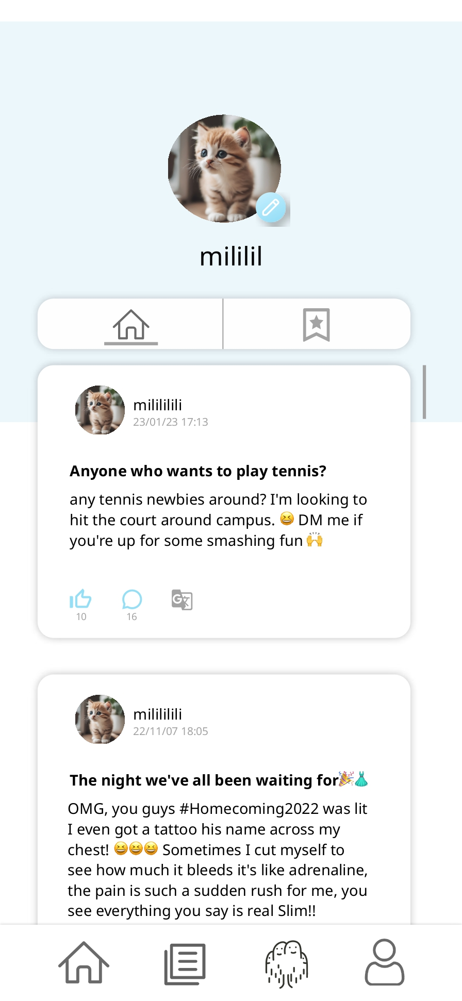
Software Engineering Team 12
BlackBox Testing
19
Team 12

Slide 20
Software Engineering Team 12
BuddyBud
04 Demonstration Video

Slide 21
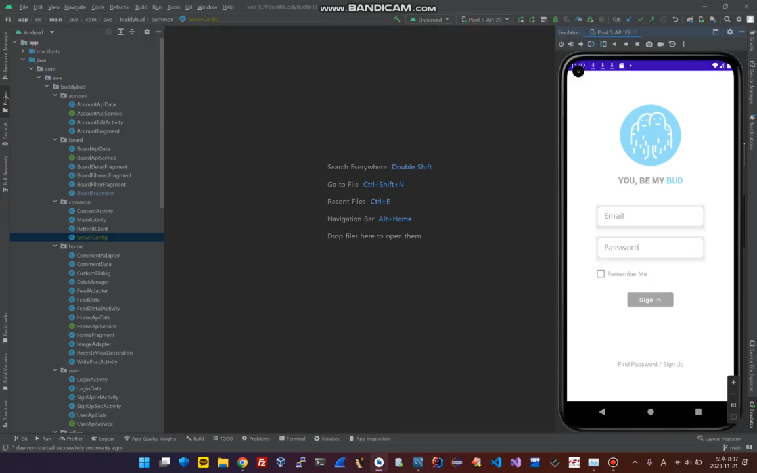
Software Engineering Team 12
Demo Video
21
Team 12

Slide 22
Software Engineering Team 12
BuddyBud
Q & A

